Slide 1


MozoHack 2.0
Team Ctrl Alt Elite

Slide 2

Team Ctrl Alt Elite
Project Track: Open Track
Team Members:
Rakshit Naidu
Aashal Kamdar
Dinesh Kumar
Harshal Raikwar

Slide 3

Problem Statement
Imagine you are a doctor who uses AI to gauge the patient’s health (for example: Pneumonia Chest X-Ray) . How would you know that the AI is ethically helping you in your task? How do you know whether your AI is capturing the “right” features for your task?

Slide 4
Solution Overview
A website that allows you to dynamically select a model and a respective Interpretability/Explainable AI technique (for Computer vision specifically; Example: SmoothGrad or Grad-CAM or Grad-CAM++ etc.) by just uploading an image. It also makes provision for inference on-the-edge which helps preserve the privacy of the user.

Slide 5
Impact
1) Easy Access for the user to understand the intuition behind how a
Neural Network works for Computer Vision tasks.
2) On-the-edge inference caters to user privacy. (Following GDPR
and HIPAA regulations)
3) A website that supports Interpretability for Computer Vision
tasks could even be used in the most remote regions of the world (where
doctors are scarce).
4) Variety of Interpretability/Explainable methods to choose from.
(IntegratedGrad, SmoothGrad, Grad-CAM, Grad-CAM++, Smooth Grad-
CAM++, Score-CAM, Smooth Score-CAM, Integrated Score-CAM).
If time permits, extend with new literature like EVET, SCOUTER and
include metrics for comparing different interpretability methods.

Slide 6
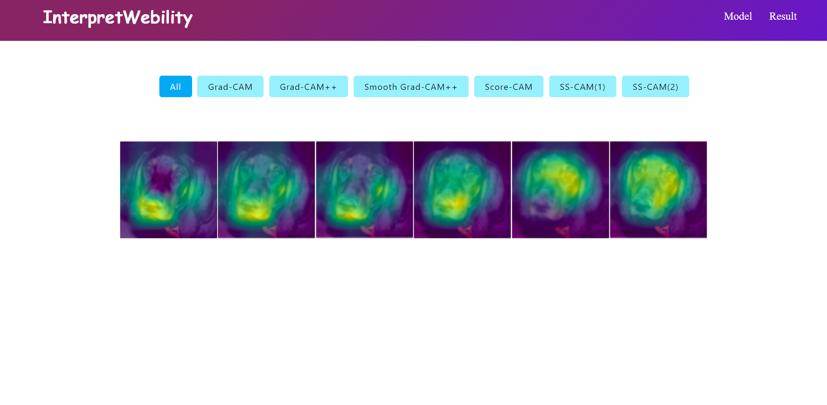
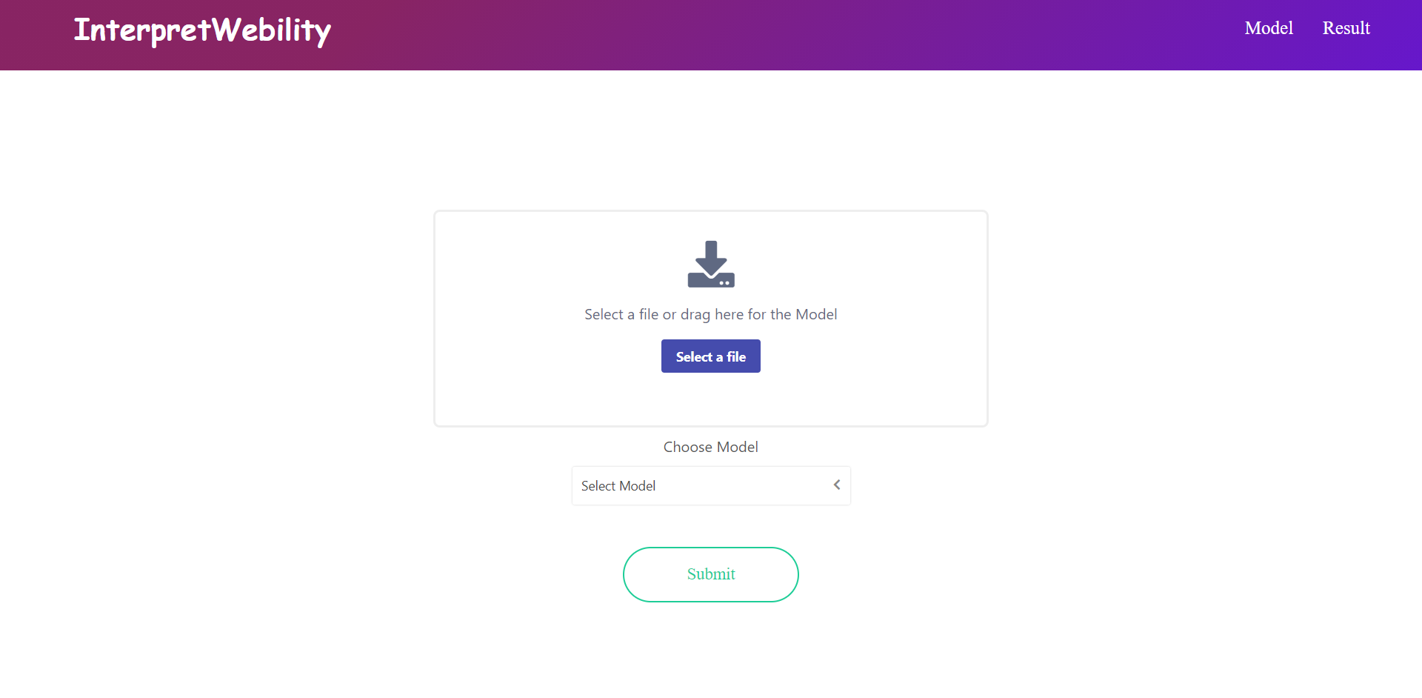
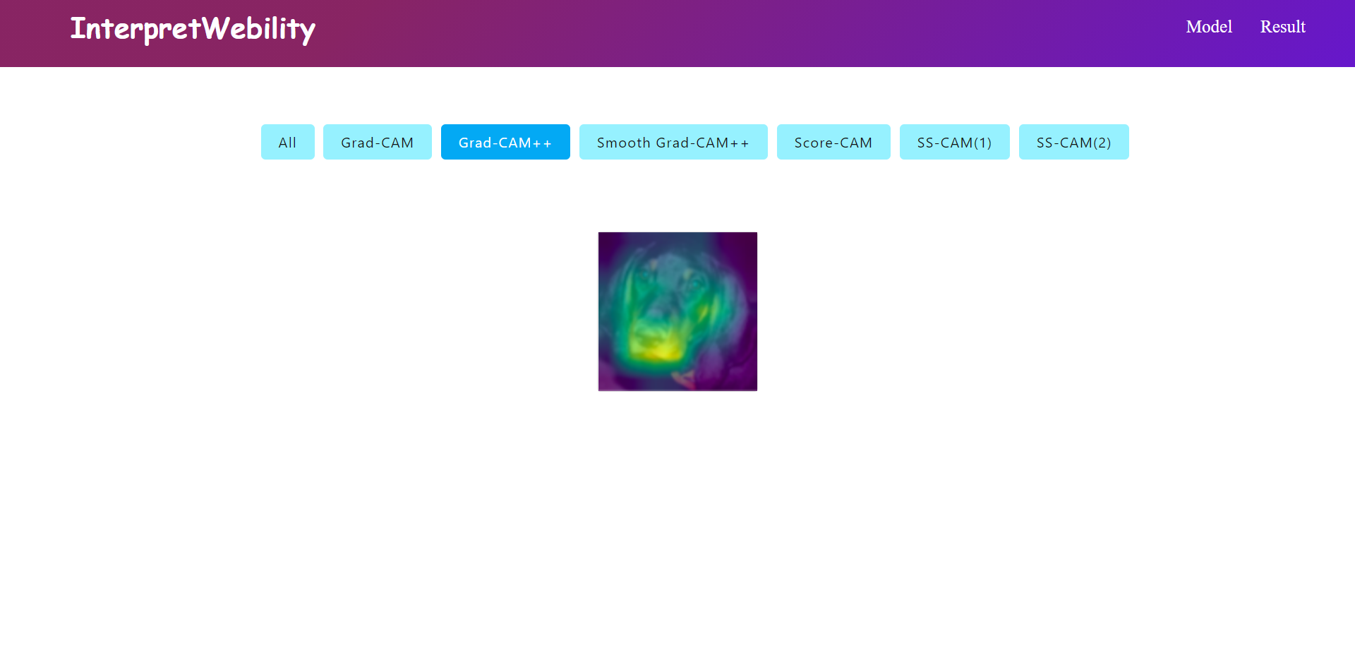
Glimpse of the site

Slide 7
THANK YOU

